Slide 1
Installation Guide
(Eclipse Plug-in － Flex Builder 3.0.2 Professional)
2008. 12. 09
CODELABOR

Slide 2
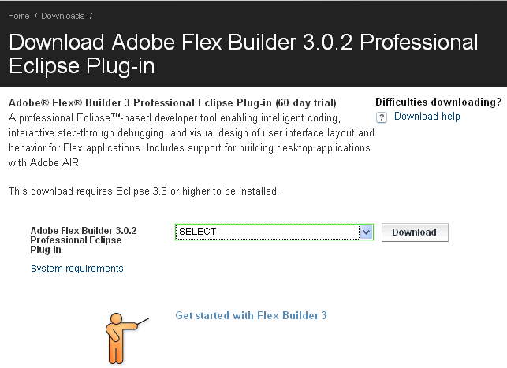

Eclipse Plug-in
Download
A professional Eclipse™-based developer tool enabling intelligent coding, interactive step-through debugging, and visual design of user interface layout and behavior for Flex applications. Includes support for building desktop applications with Adobe AIR.
Officical Site: http://www.adobe.com
Download site URL: http://www.adobe.com/cfusion/tdrc/index.cfm?product=flex_eclipse&loc=en_us
Download File: FB3_WWEJ_Plugin.exe

Slide 3
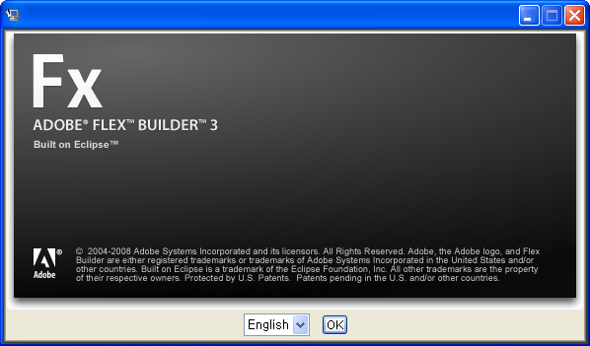
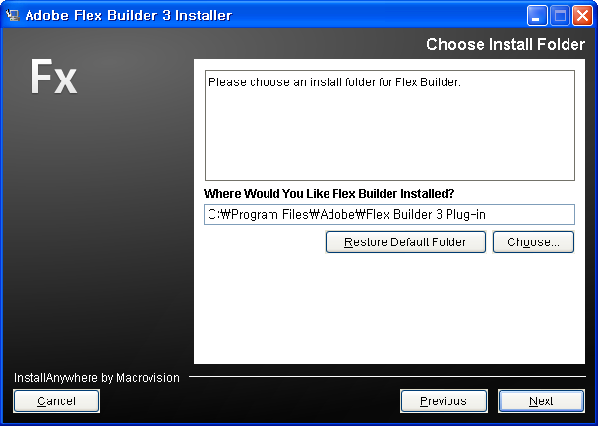
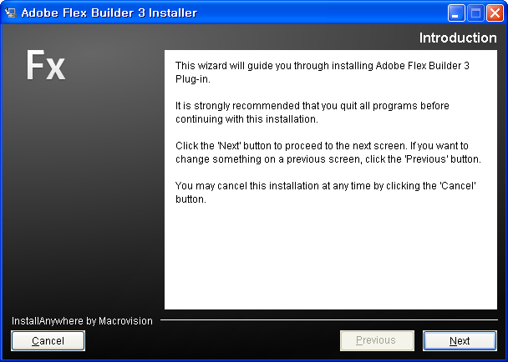
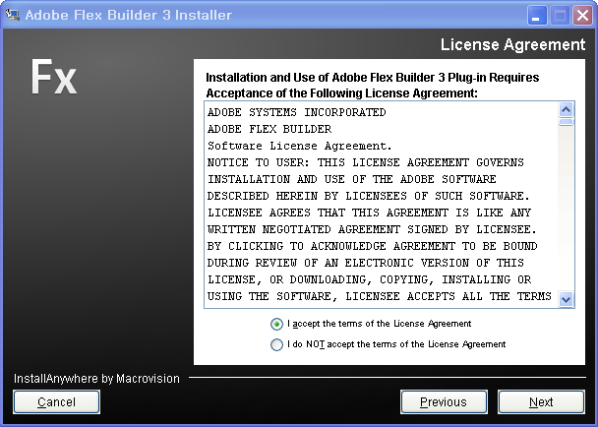
Eclipse Plug-in
Installation

Slide 4
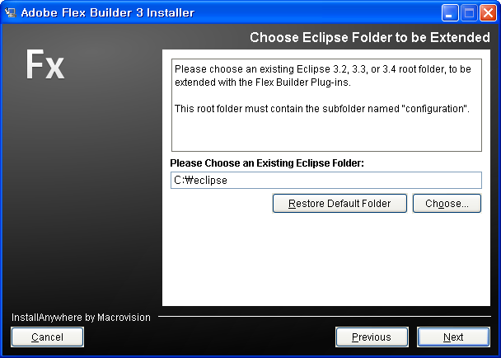
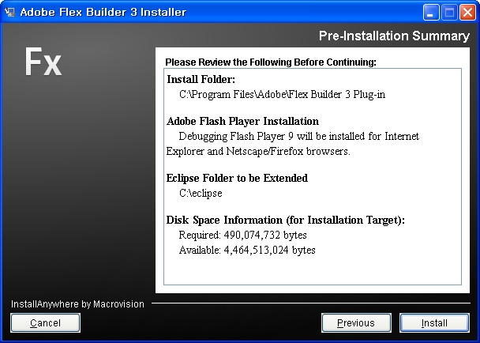
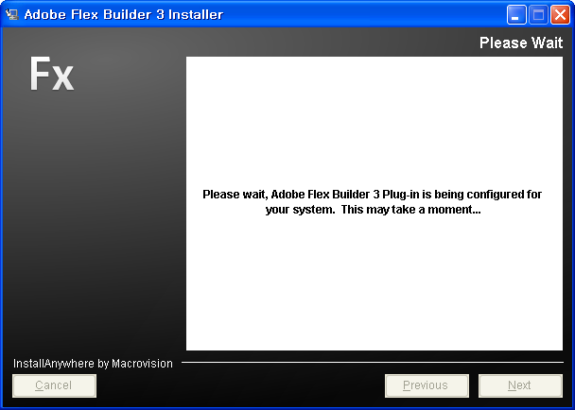
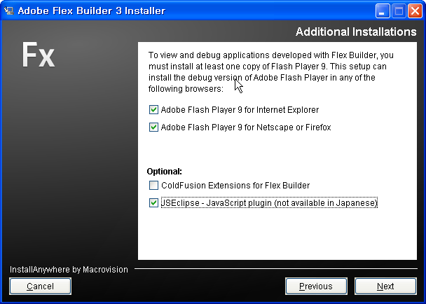
Eclipse Plug-in
Installation

Slide 5
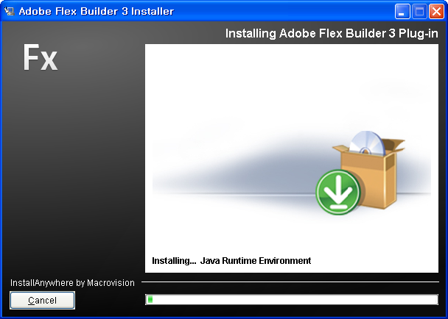
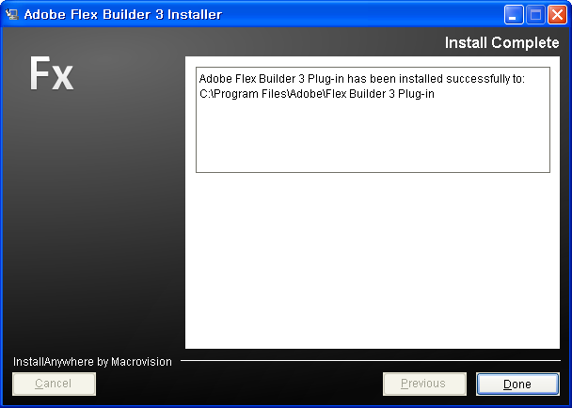
Eclipse Plug-in
Installation

Slide 6
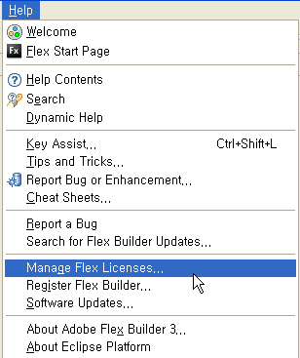
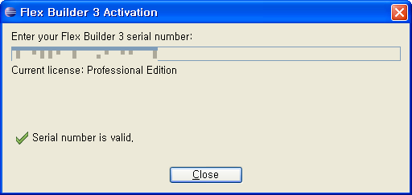
Eclipse Plug-in
License

